Slide 1
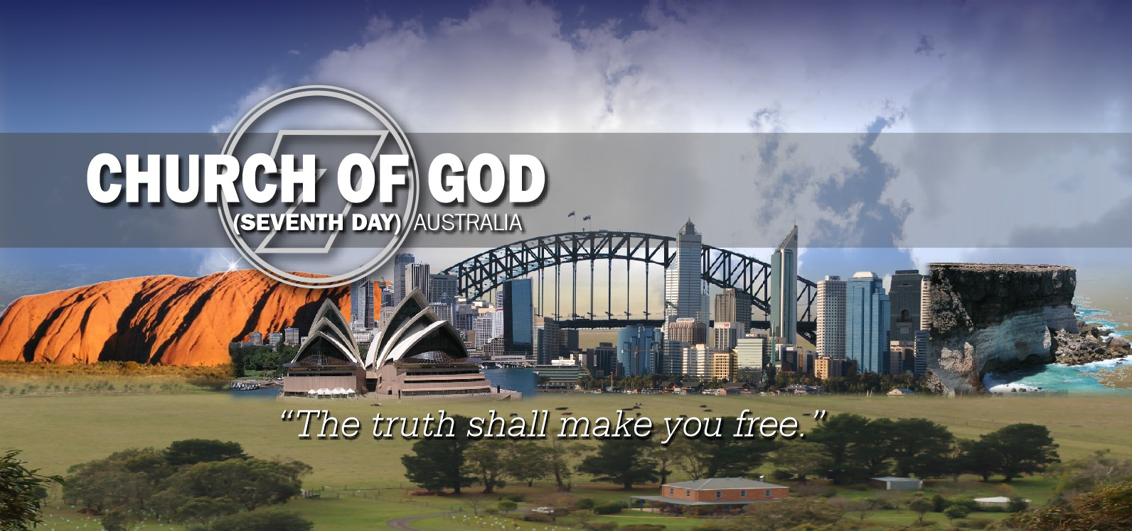







21 December 2025
THE TRUTH SHALL MAKE YOU FREE
Sponsored and supported by
Church of God (Seventh Day) Australia, Christian Education Services Australia, Church of God (Seventh Day) International Federation, Messageweek Ministries

Slide 2
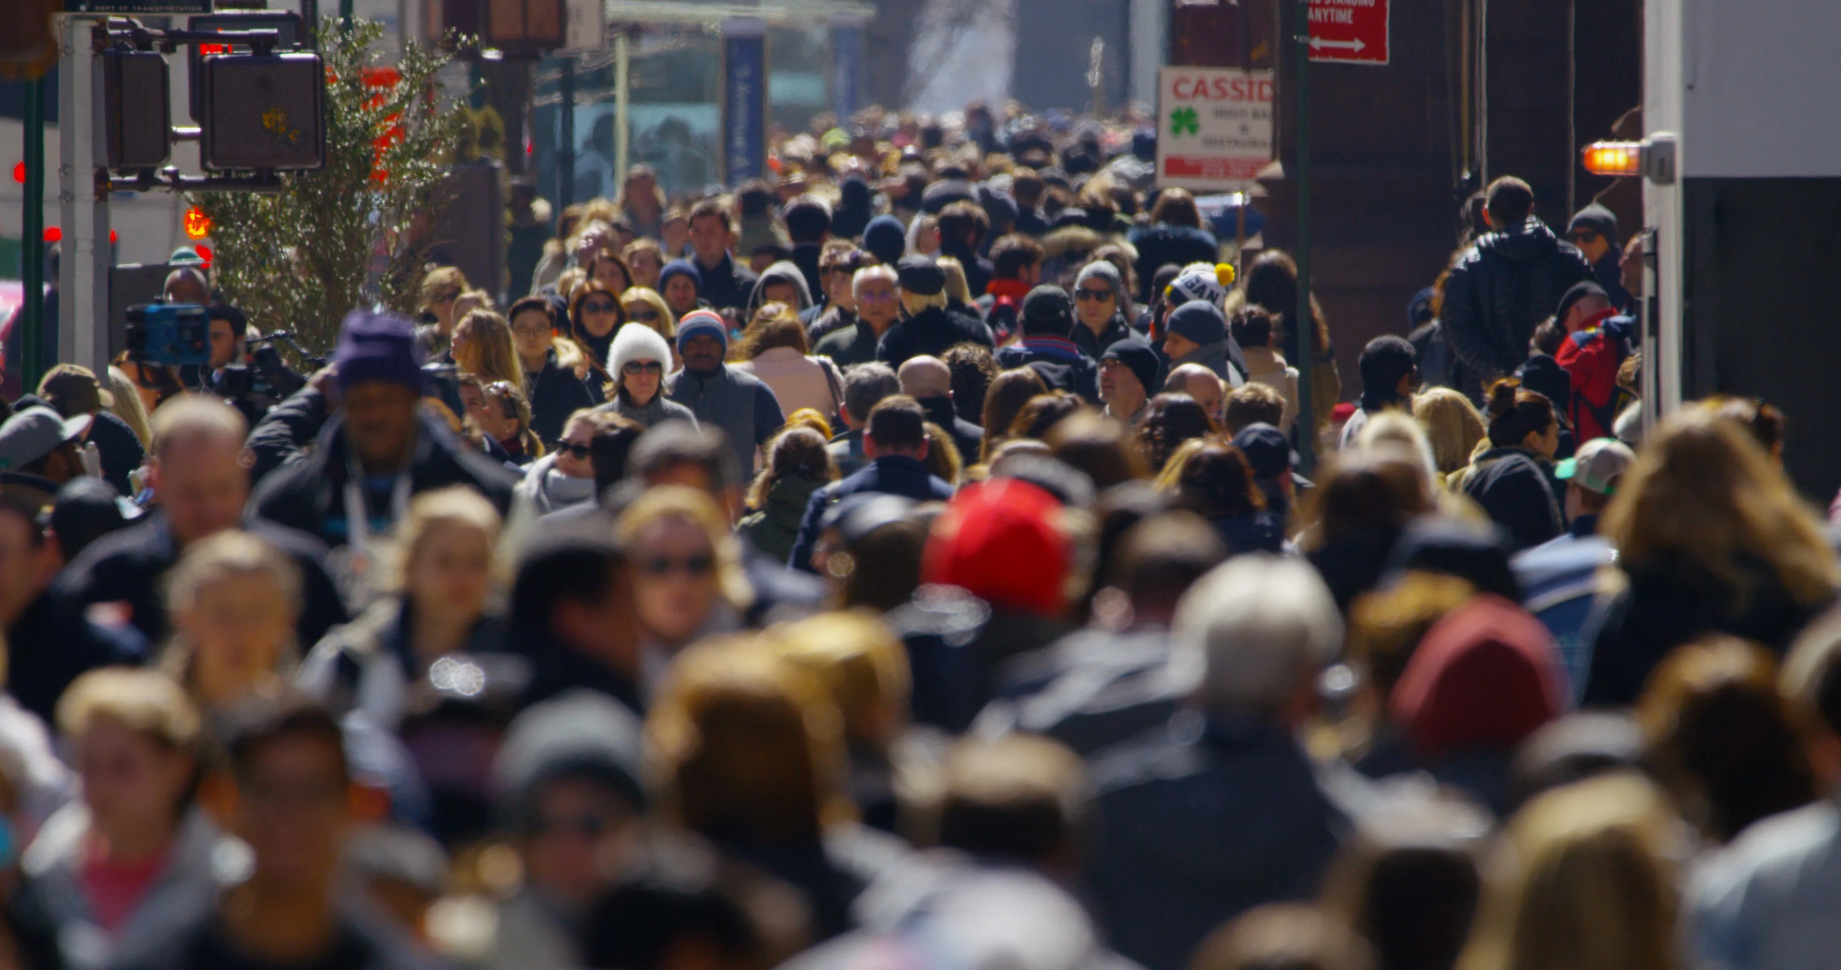


Slide 3
John 5:28-29 ESV Do not marvel at this, for an hour is coming when all who are in the tombs will hear his voice (29) and come out, those who have done good to the resurrection of life, and those who have done evil to the resurrection of judgment.
John 5:28-29 NKJV Do not marvel at this; for the hour is coming in which all who are in the graves will hear His voice (29) and come forth-- those who have done good, to the resurrection of life, and those who have done evil, to the resurrection of condemnation.

Slide 4
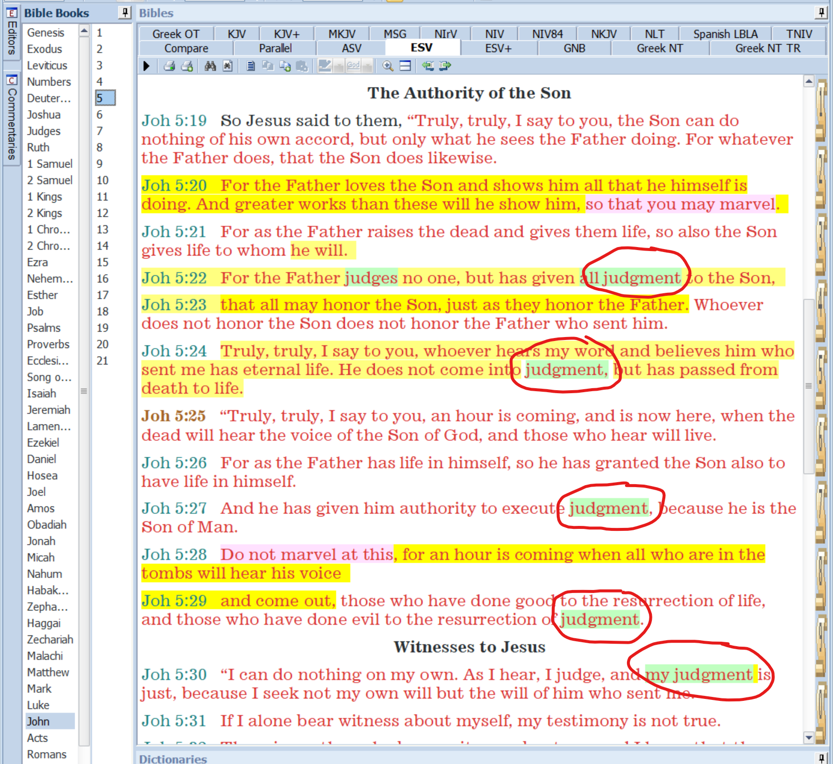
Κρίσις
krisis

Slide 5
John 5:28-29 ESV Do not marvel at this, for an hour is coming when all who are in the tombs will hear his voice (29) and come out, those who have done good to the resurrection of life, and those who have done evil to the resurrection of judgment.
John 5:28-29 NKJV Do not marvel at this; for the hour is coming in which all who are in the graves will hear His voice (29) and come forth-- those who have done good, to the resurrection of life, and those who have done evil, to the resurrection of condemnation.

Slide 6
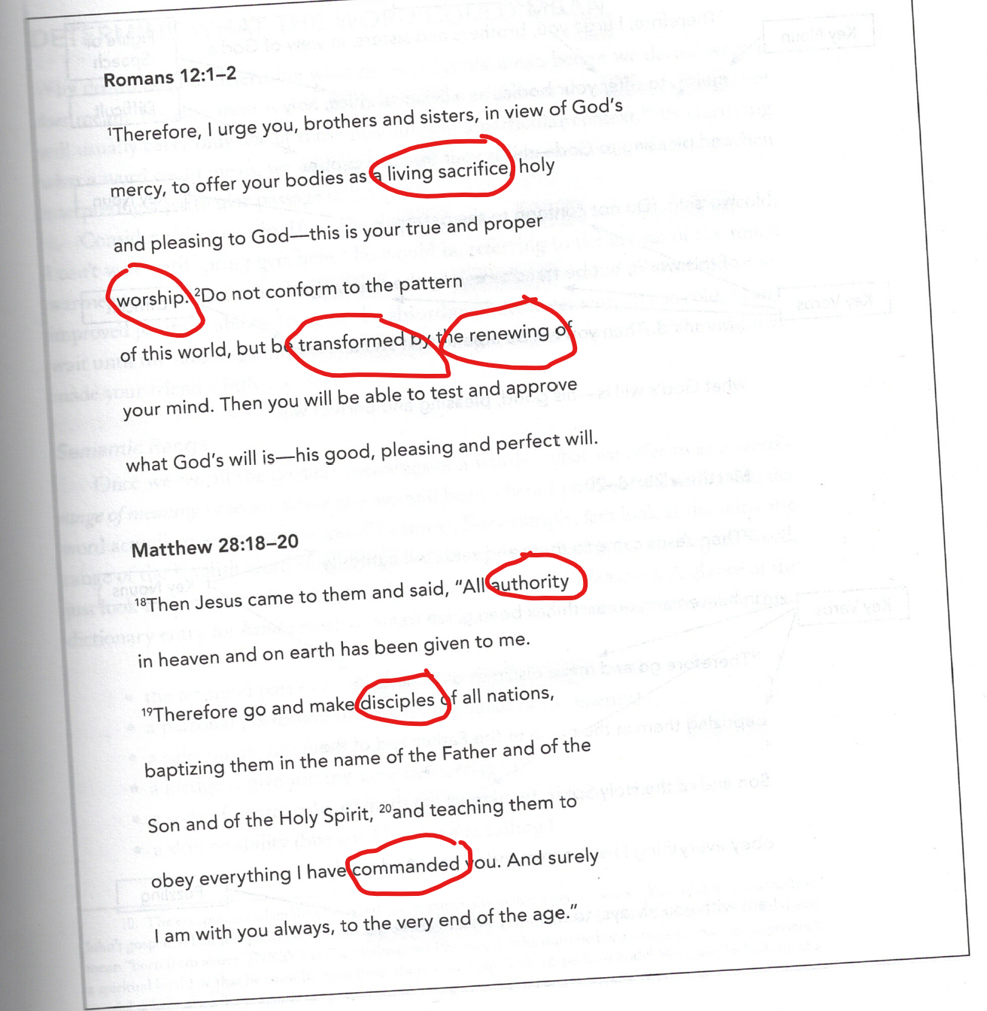

Slide 7
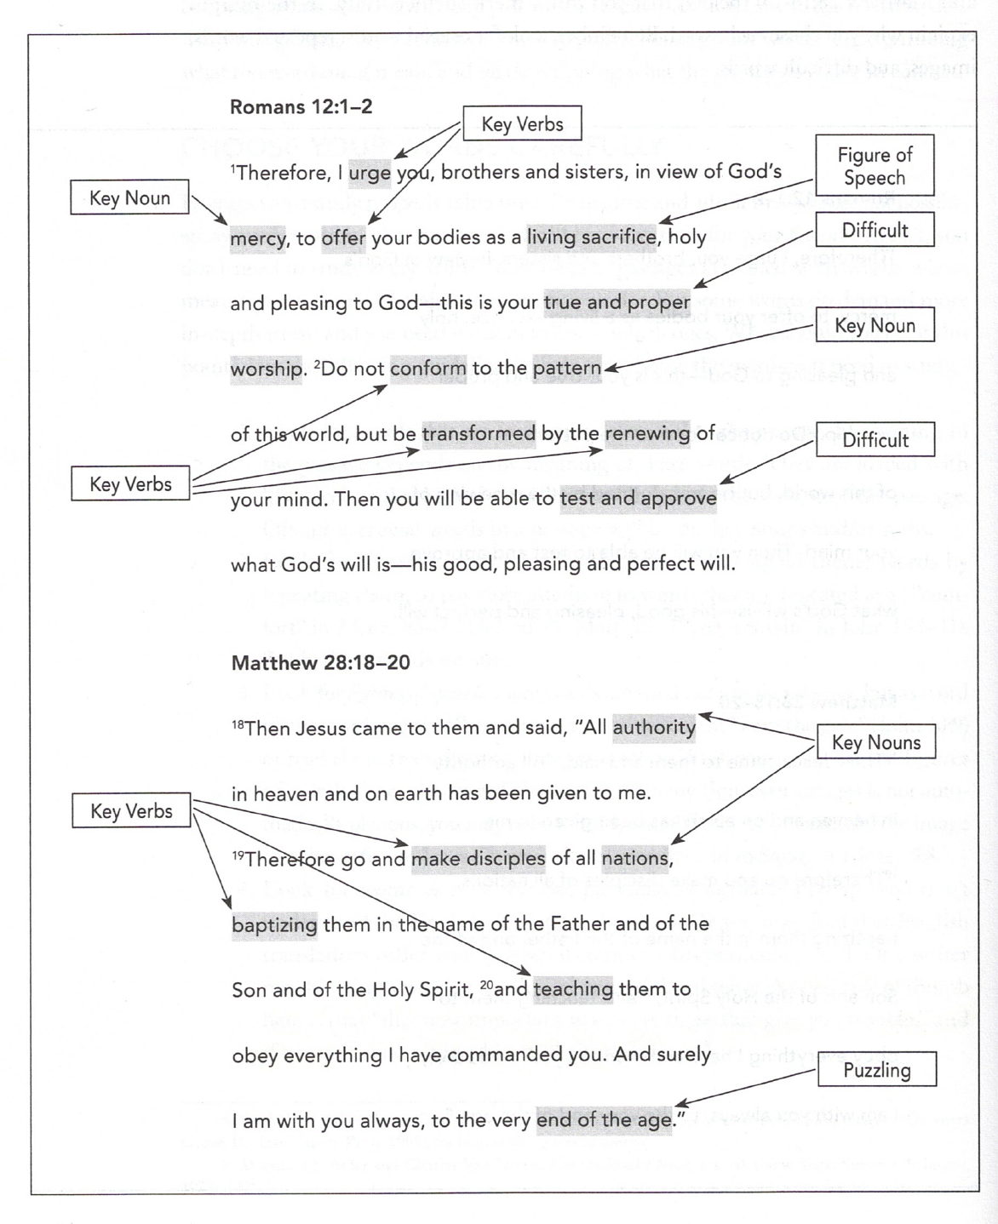

Slide 8
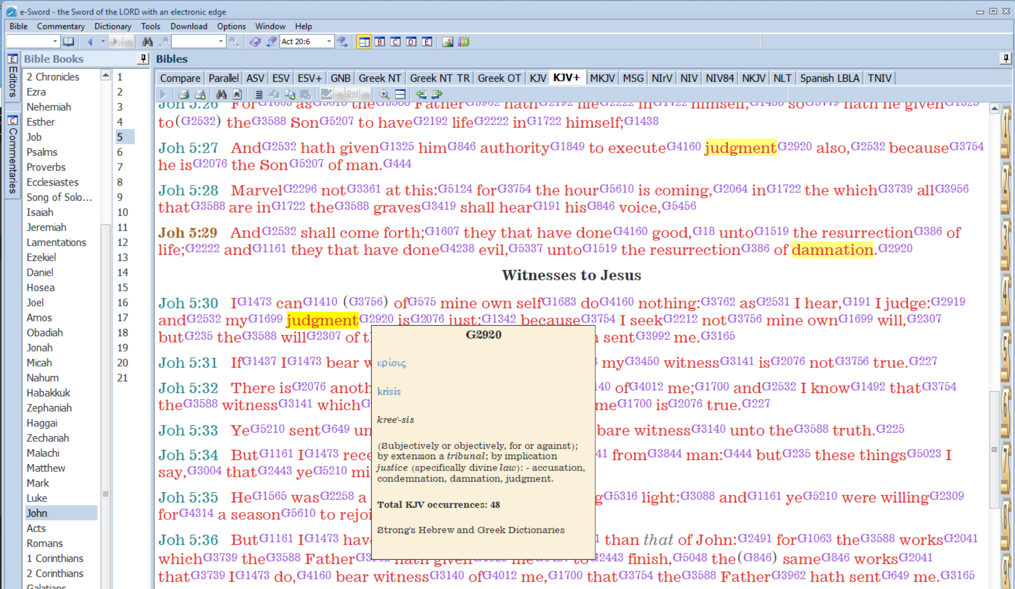

Slide 9
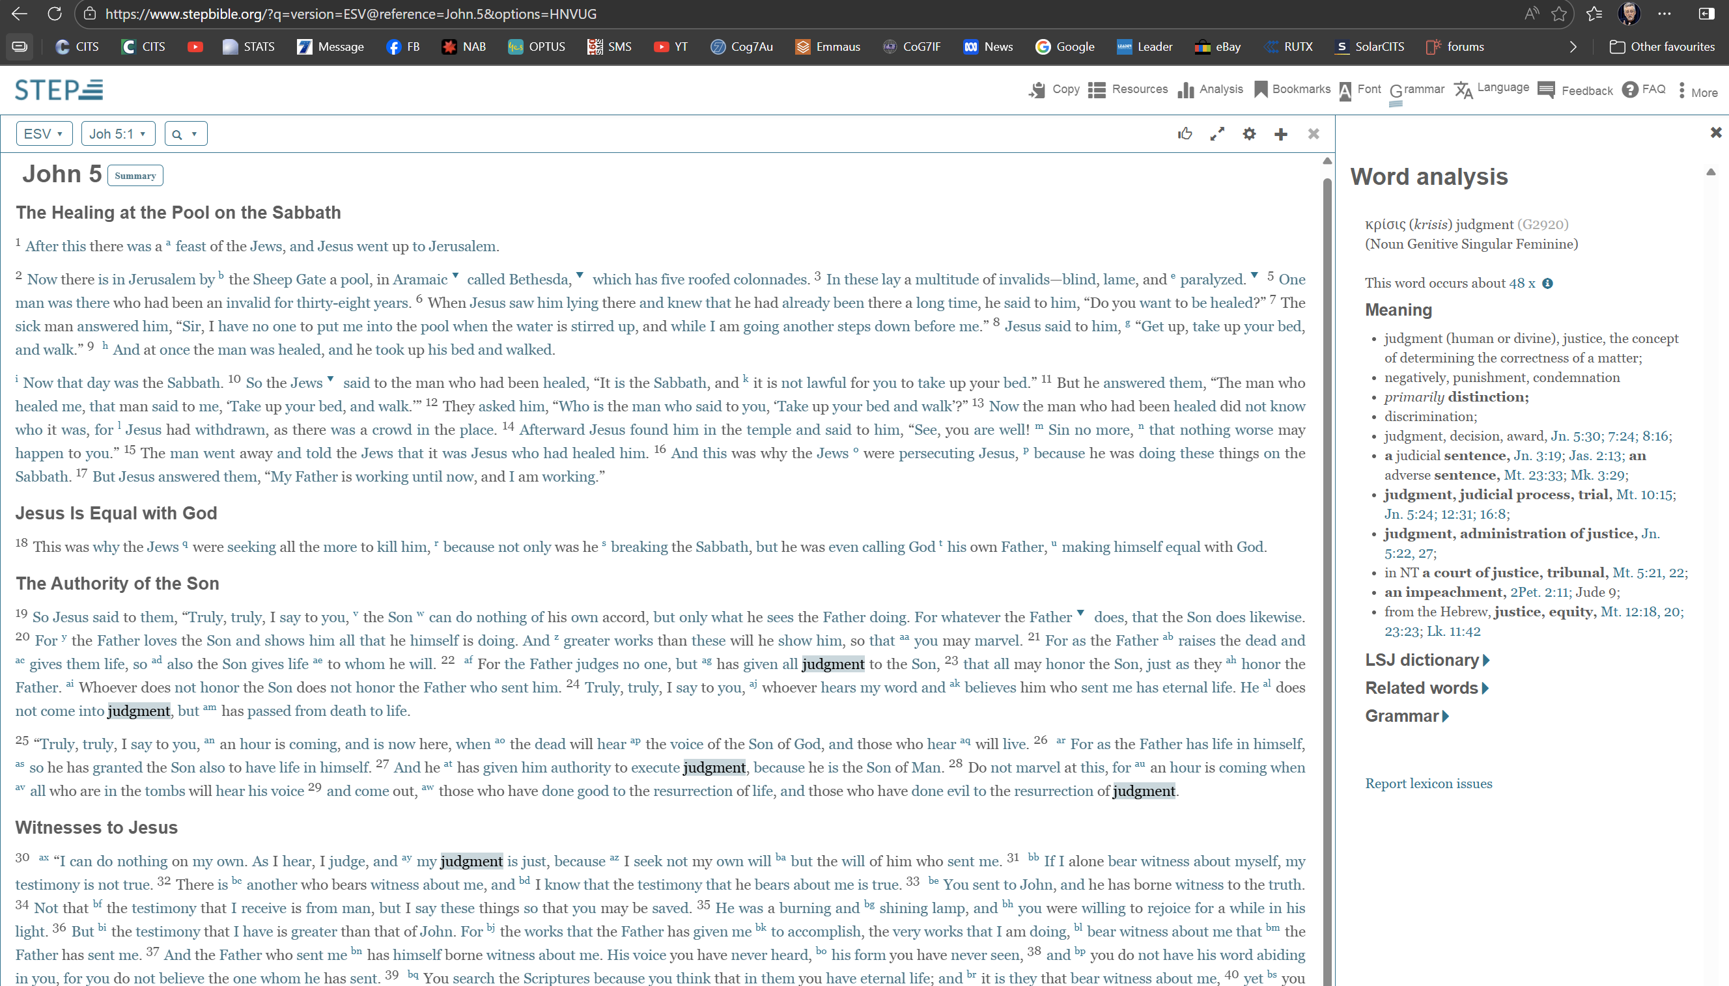
https://www.stepbible.org/

Slide 10
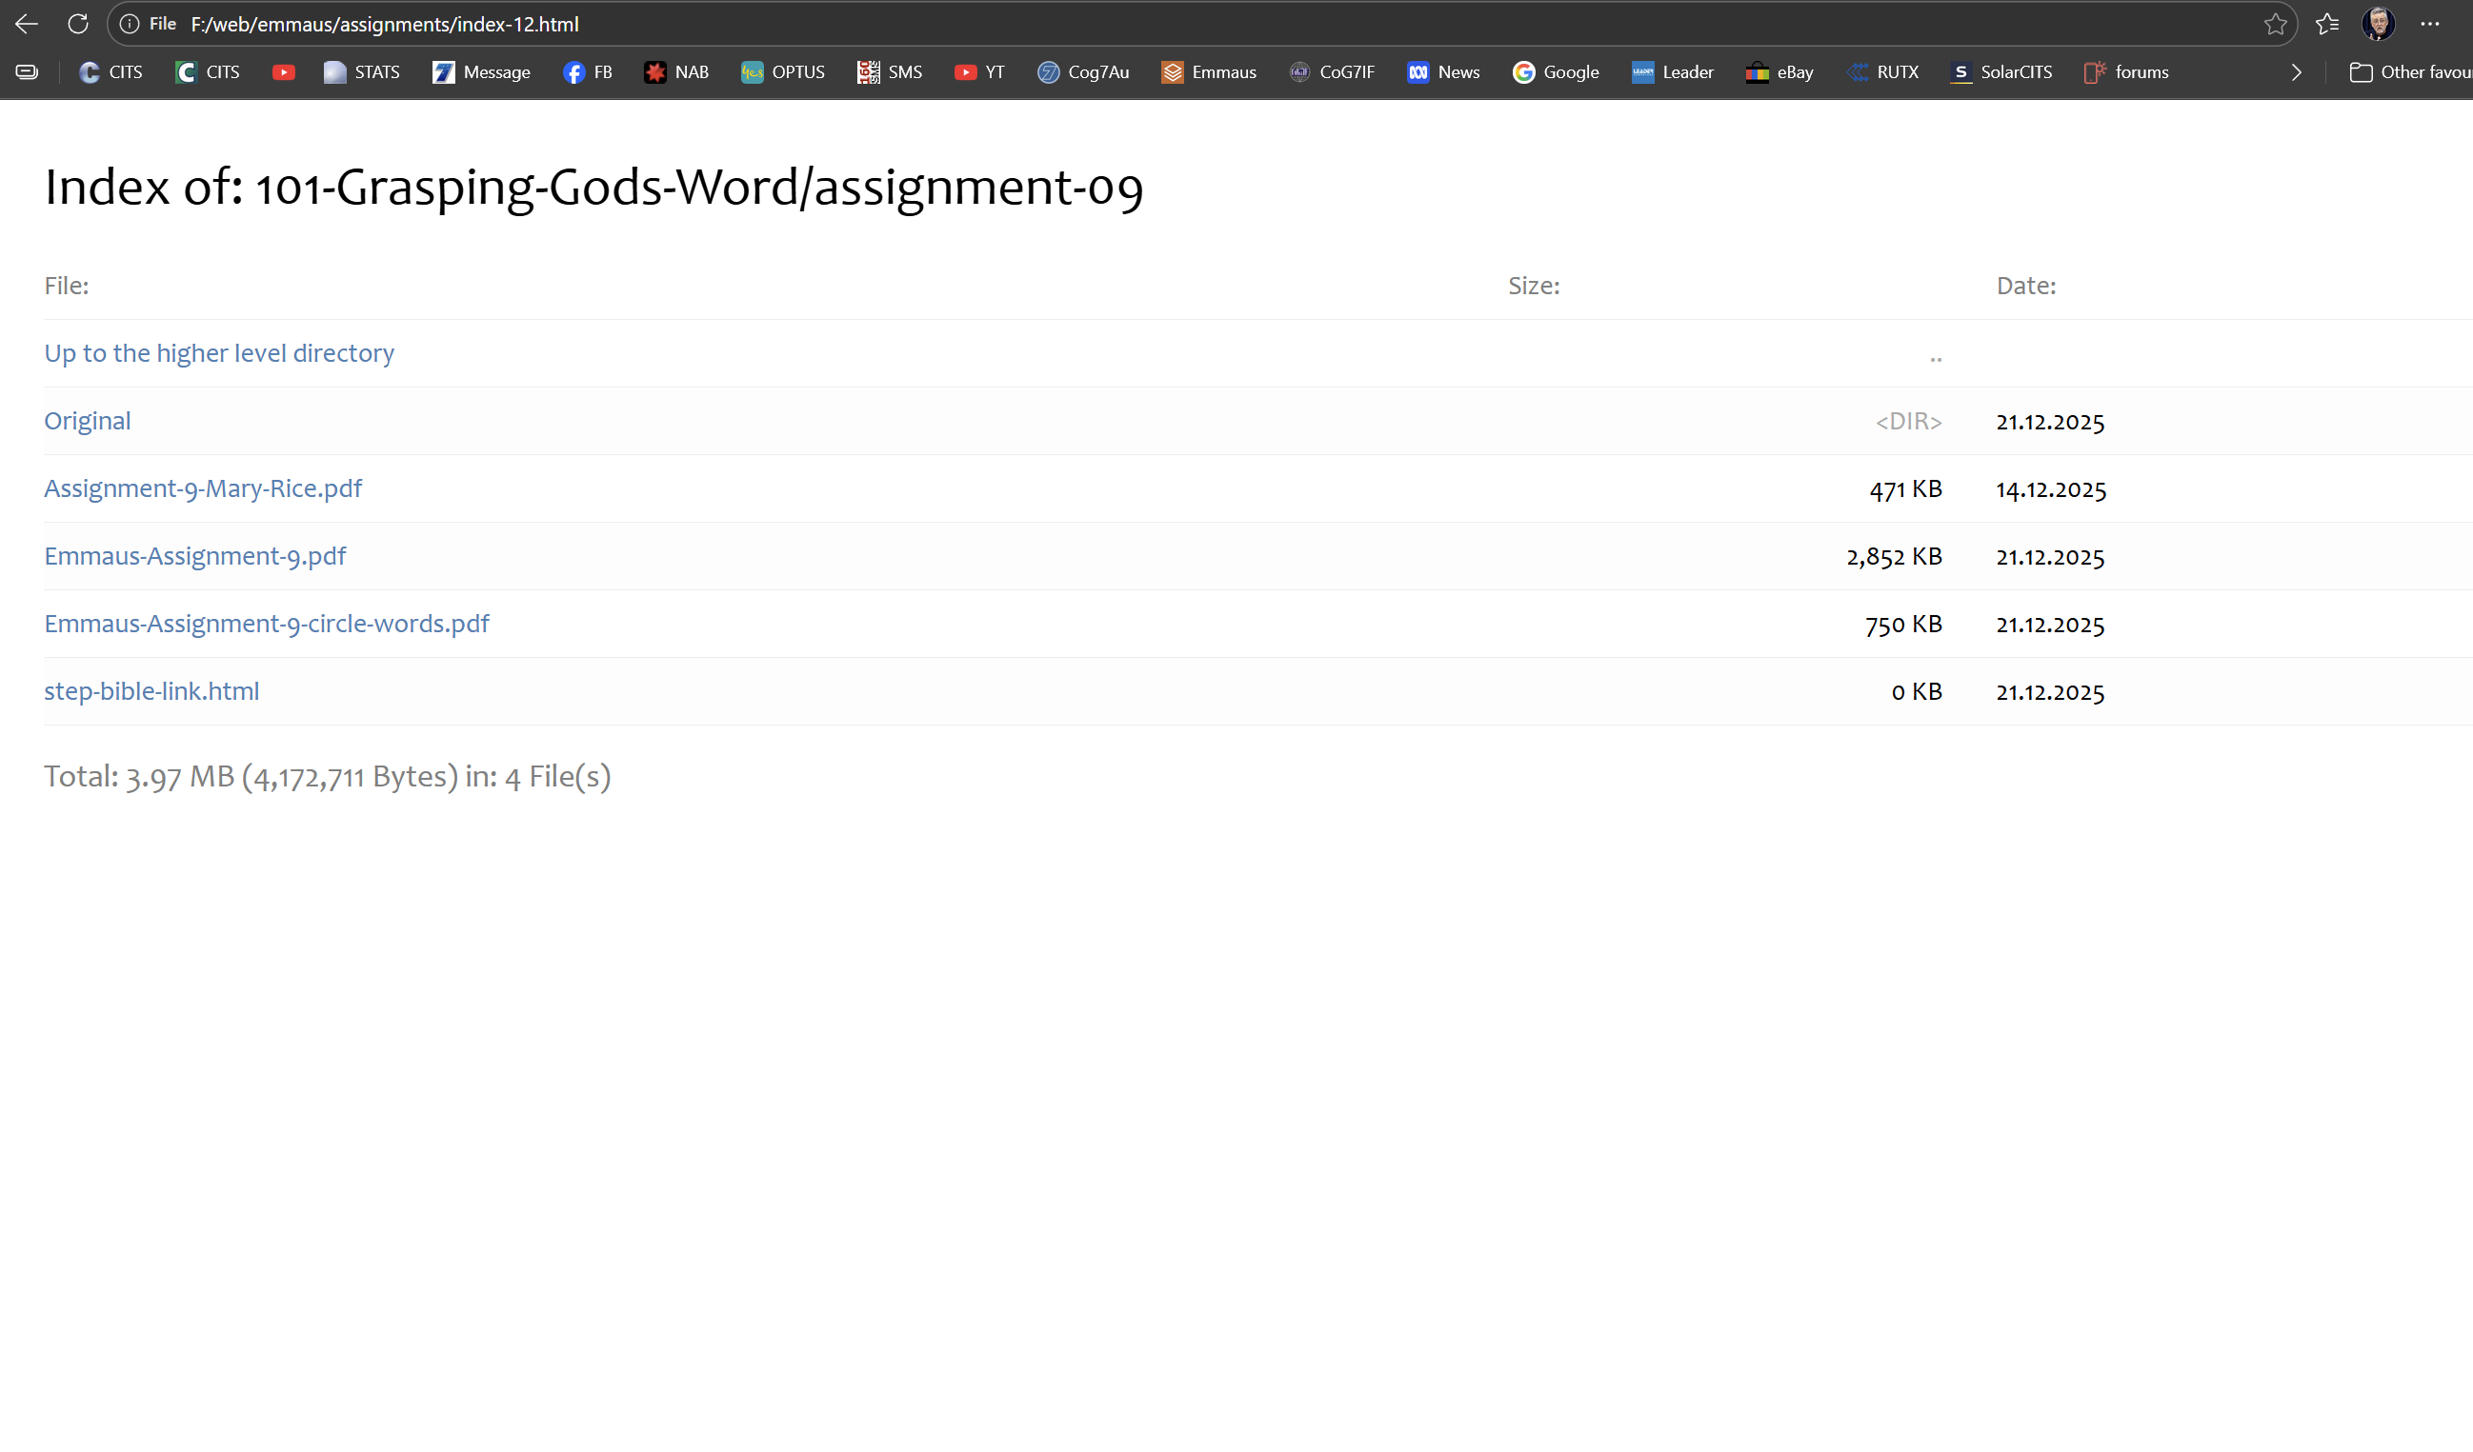

Slide 11
Text

Slide 12

THE TRUTH SHALL MAKE YOU FREE
Sponsored and supported by
Church of God (Seventh Day) Australia, Christian Education Services Australia, Church of God (Seventh Day) International Federation, Messageweek Ministries

